Slide 1
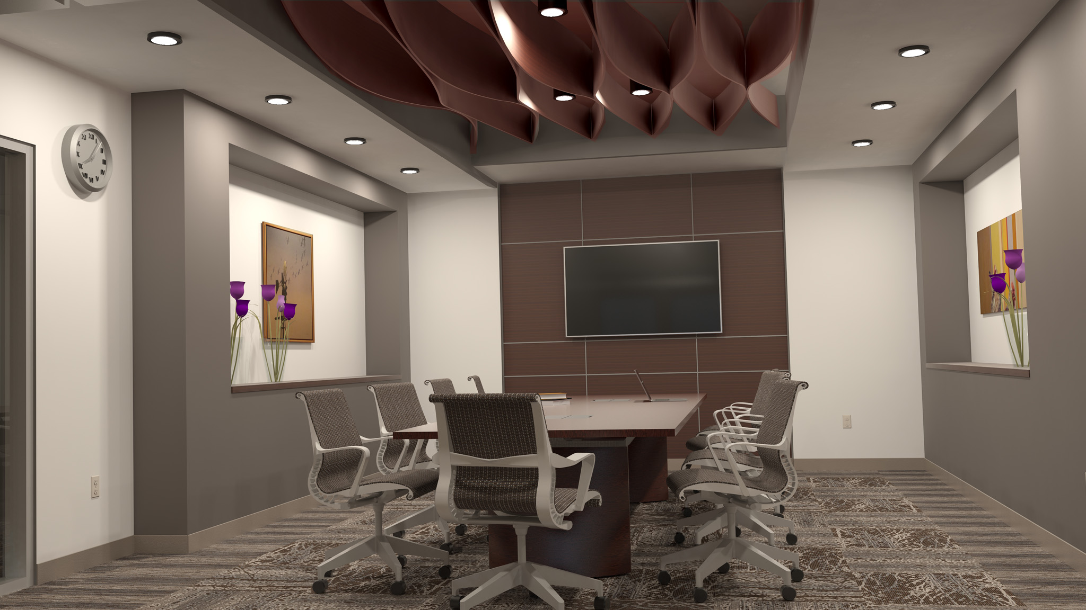
Autodesk Showcase & Revit :
SHOWCASING your Revit Model
Ryan B. Cameron, AIA, LEED AP, EDAC, NCARB ryan@ryanbakercameron.com
Architectural Consultant www.ryanbakercameron.com
Lincoln, Nebraska
Showcase your Revit Model

Slide 2
Welcome to RUGON!
Autodesk Showcase with Revit
Tips and Tricks
Next: Course Overview
Showcase your Revit Model

Slide 3
Using Showcase with a Revit Model
Presentation Details:
1 - Explanation of what Showcase is and is not
2 – A Pair of Uses: As Presentation Tool and as Design Option replacement
3 – Common Tools/shortcuts
4 – User Interface
5 – Combining Revit and Showcase – Workflow Suite vs. Import/Export
6 – Pitfalls and what to avoid
7 – Demonstration of Showcase
Showcase your Revit Model

Slide 4
1 - Explanation
What is Showcase?
It IS another BIM tool used to combine with your Revit model for presentations to clients and used for in-house form/material finding.
It is NOT a modeling tool. It is NOT a “show me square footages” tool.
It IS about the “look and feel” or the “Experience” of the space. Clients may need confidence that the space will look like their expectations.
Showcase your Revit Model

Slide 5
1 - Explanation
What is Showcase?
It IS another BIM tool used to combine with your Revit model for presentations to clients and used for in-house form/material finding.
It is NOT a modeling tool. It is NOT a “show me square footages” tool.
So why use Showcase?
Model Management: - Project Managers can get into the Revit model without the BIM Manager worrying about whether or not they will accidently make changes to the model.
Data Resource: Each import from Revit creates a unique set of materials to that model’s place and time. Being able to go back to this model a week or a month later could save time from having to find notes or remembering what material was placed on an arrangement certain walls.
Showcase your Revit Model

Slide 6
1 - Explanation
Why use Showcase?
Client Tool: - Presenting design ideas or current iterations of the model. Demonstrate furniture layouts, wall, door, window placements. Including overall aspects of the design such as color, material and form.
Showcase your Revit Model

Slide 7
1 - Explanation
What is Showcase?
Using Showcase is not about solving particular Revit issues
It also is not just about creating presentations
It IS about finding answers.
Showcase your Revit Model

Slide 8
1 - Explanation
What is Showcase?
Using Showcase is not about solving particular Revit issues
It also is not just about creating presentations
It IS about finding answers.
Showcase your Revit Model

Slide 9
2 – Pair of Uses: Presentations
Why use Showcase?
Clients are asking for more 3D, more customization and more options than ever before. There is a need to be able to present these ideas in a more effective tool than Revit alone.
Demo Video
Showcase your Revit Model

Slide 10
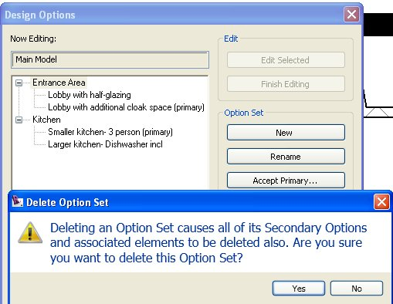
2 – Pair of Uses: D.O. Replacement
Why use Showcase?
Why?
Who loves Design Options?
…on top of Linked Models?
...on top of Worksets?
…in a restoration project with unknown conditions?
….AND three phases of construction?
AND you have inexperienced personnel added to the team?
We’ll review in a minute how to use Showcase to avoid a few of these steps.
Showcase your Revit Model

Slide 11
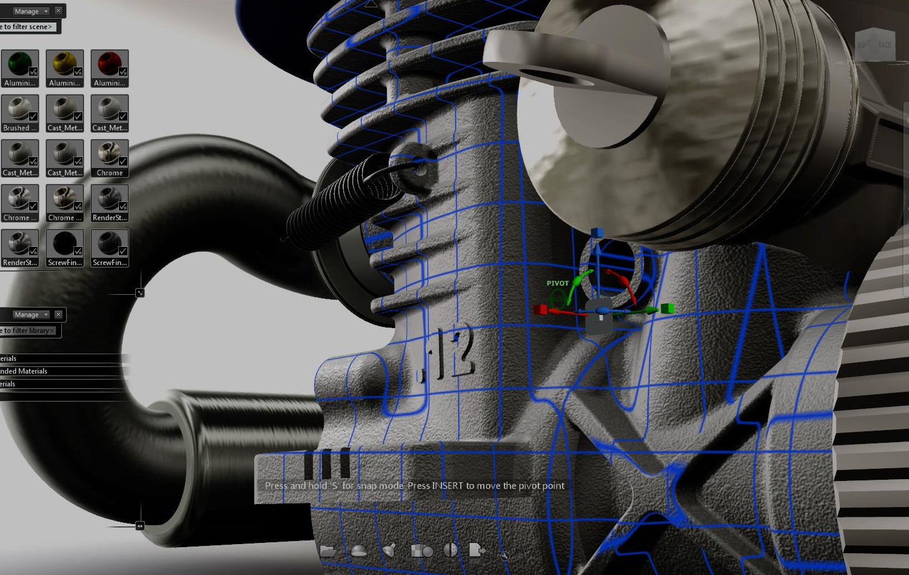
3 – Common Tools and Shortcuts
Shortcut Keys for Showcase 2013
I Import Status Window
M Materials
Ctrl+M Edit Material
E Environment Library
V Visual Styles
X Add section
H Turn on grips
T Shots
B Behaviors
A Alternatives
U Storyboard
Tab Key Presentation Mode
Showcase your Revit Model

Slide 12
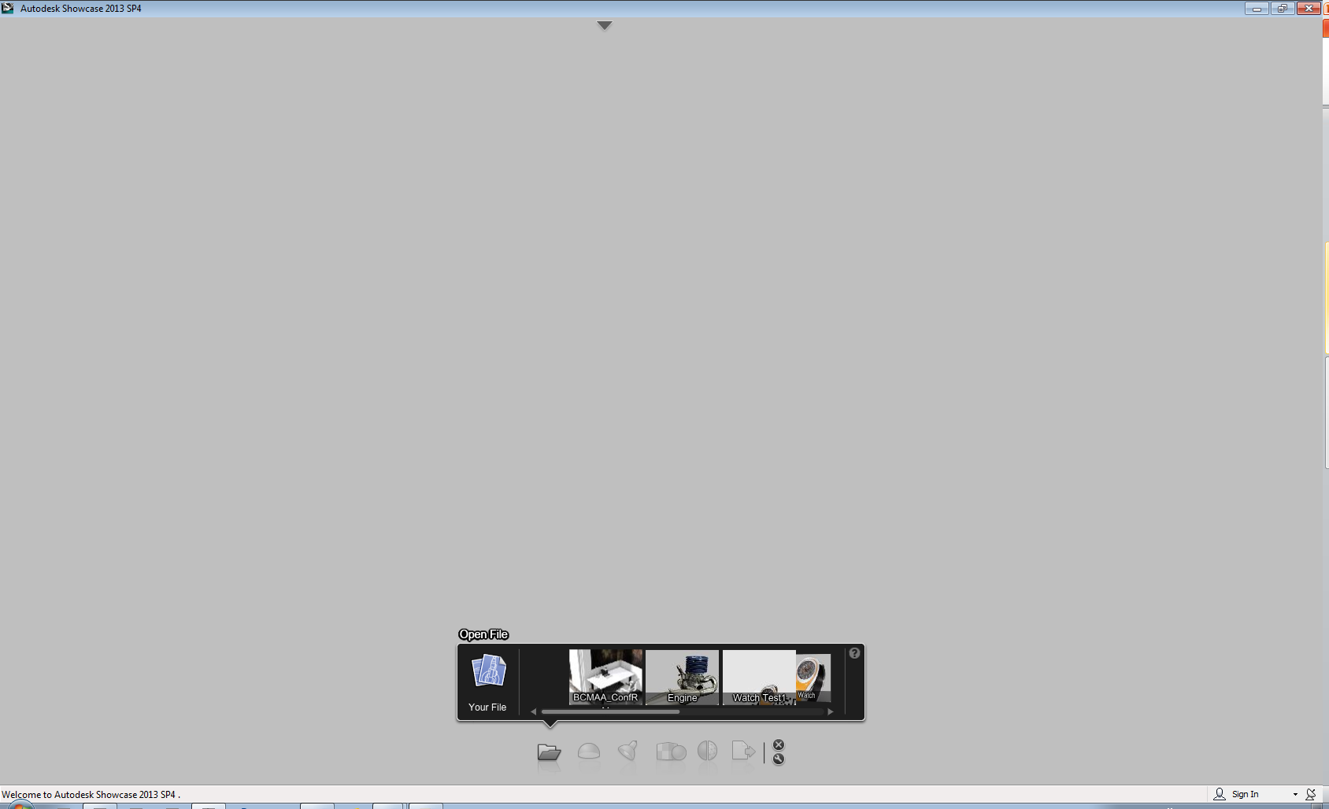
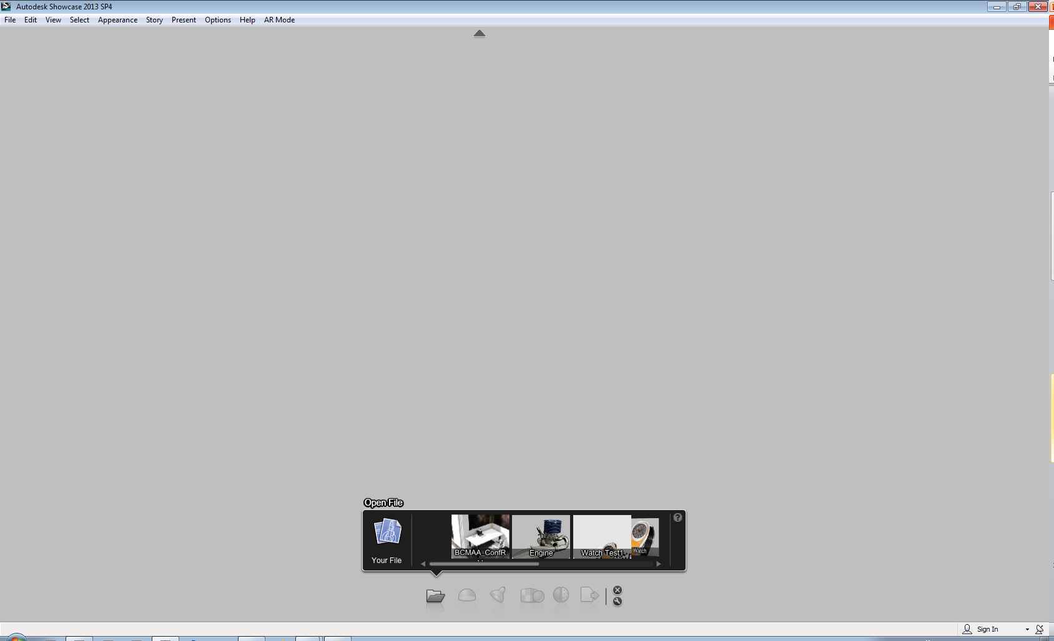
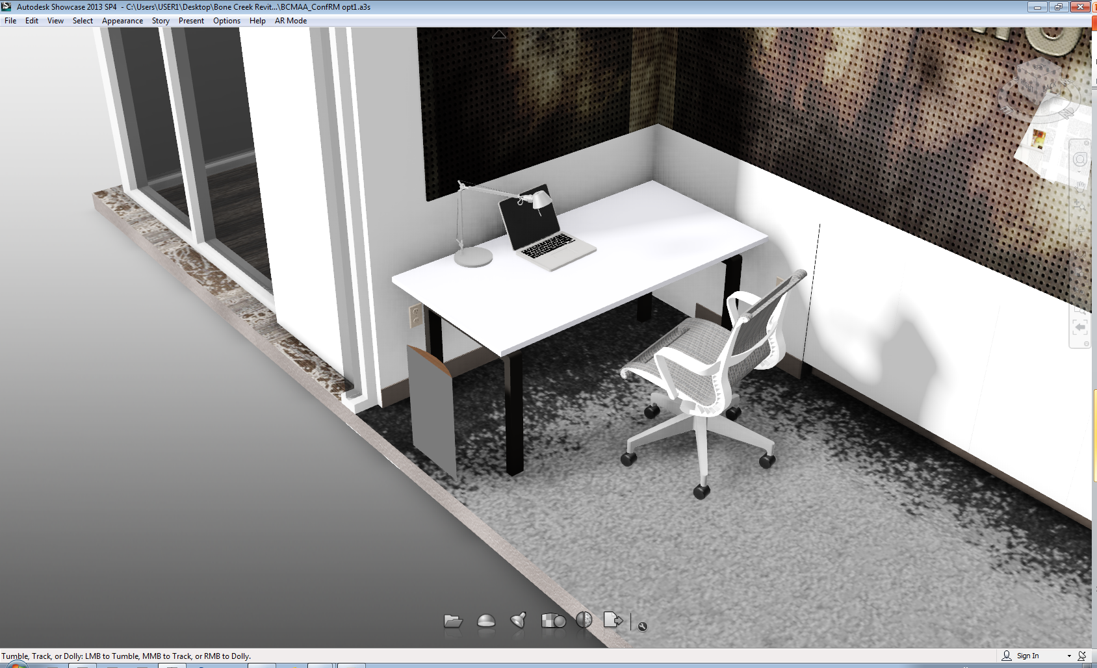
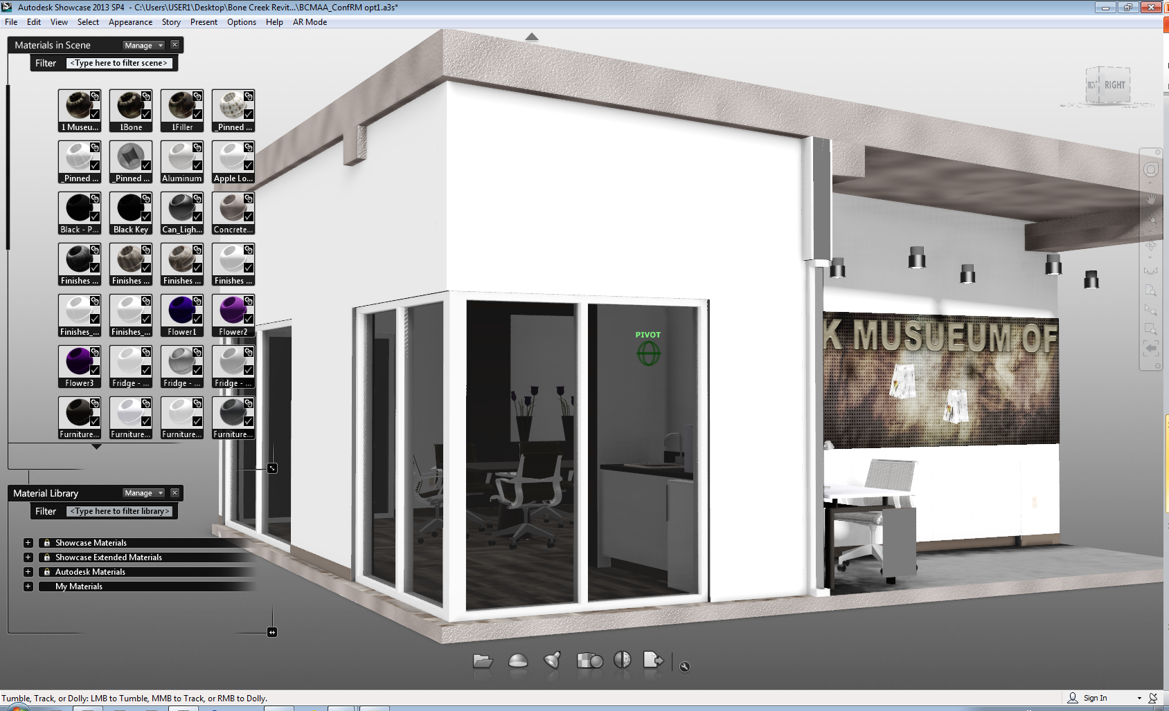
4 – User Interface
User Menus
Limited Tool bars – Maximum Screen area
File Locations – Quick Menu
Showcase your Revit Model

Slide 13
4 – User Interface
User Menus
Limited Tool bars – Maximum Screen area
File Locations – Quick Menu
Showcase your Revit Model

Slide 14
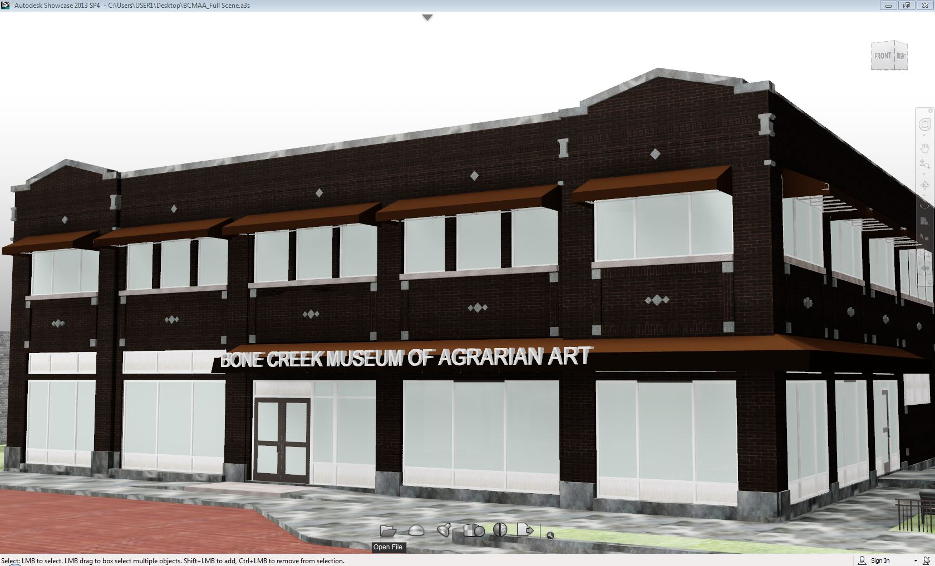
4 – User Interface - Visual Display Settings
Showcase your Revit Model

Slide 15
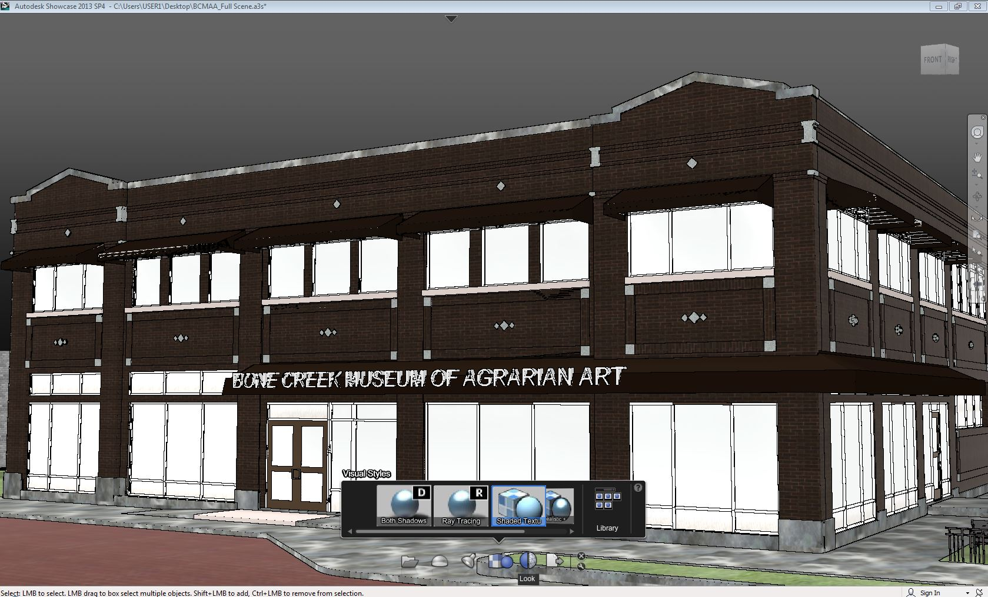
4 – User Interface - Visual Display Settings
Showcase your Revit Model

Slide 16
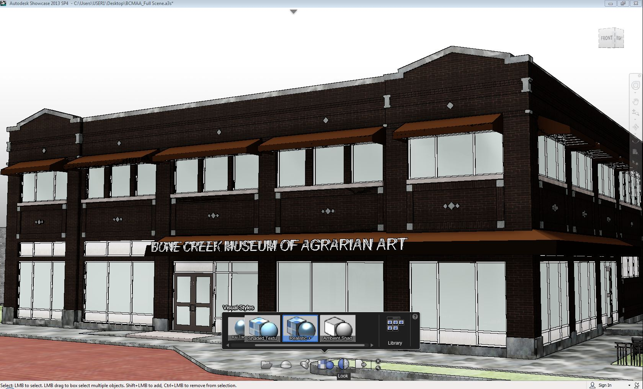
4 – User Interface - Visual Display Settings
Showcase your Revit Model

Slide 17
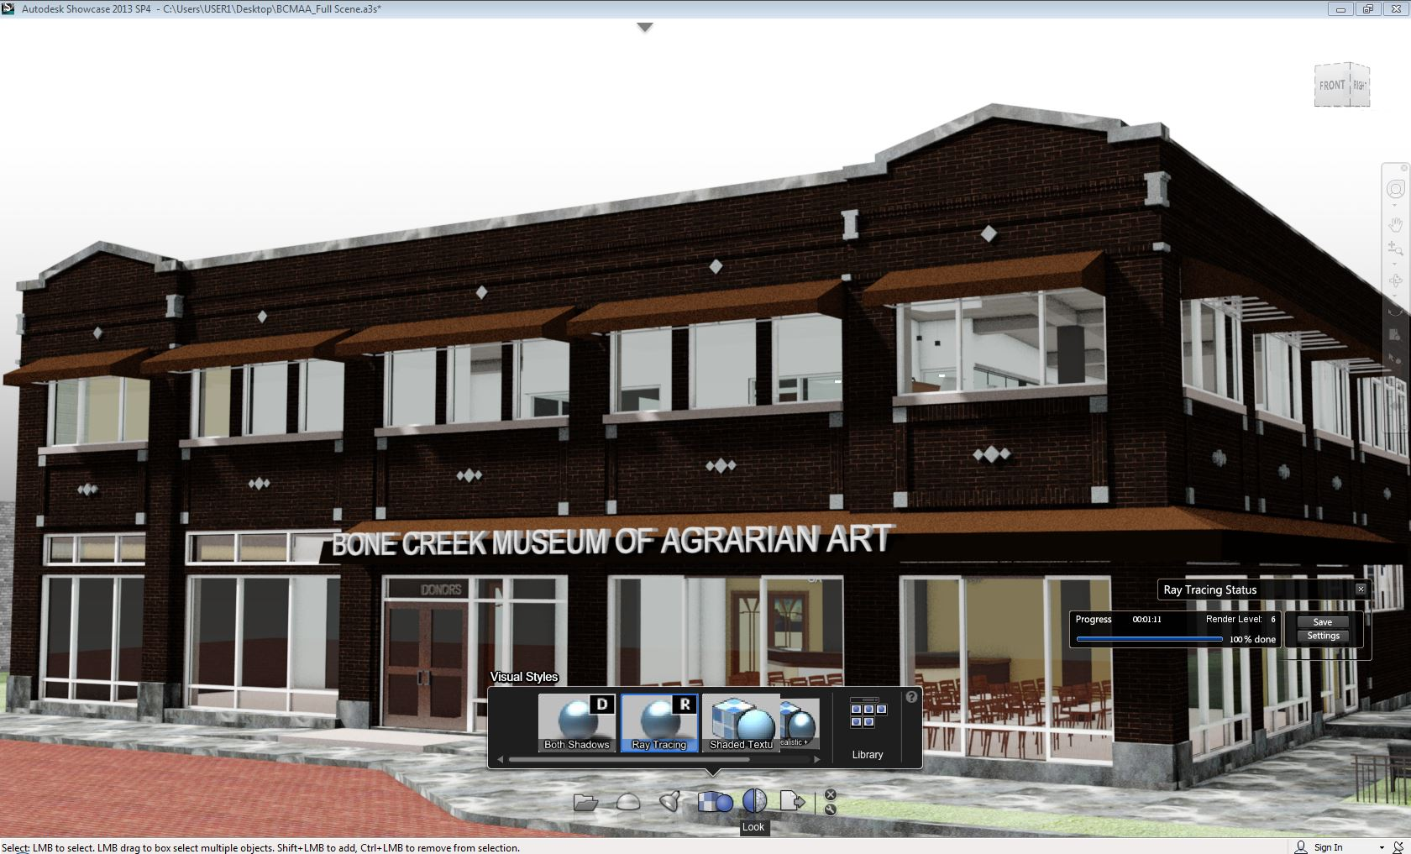
4 – User Interface - Visual Display Settings
Showcase your Revit Model

Slide 18
5 – Workflow Suites vs. Import/Export FBX
New for 2013 (on subscription) - Workflow Suites
- Optimizes use of the current *.rvt model used per project
- No other tie-in’s required (file types, menus, materials)
- No extra files laying around on the server
Previous solution was to export the Revit model as an .FBX (FilmBoX)
standardized object file and import it directly to Showcase.
This process takes an extra step and will be the workflow I show in this real-project demonstration since marginally more involved.
Showcase your Revit Model

Slide 19
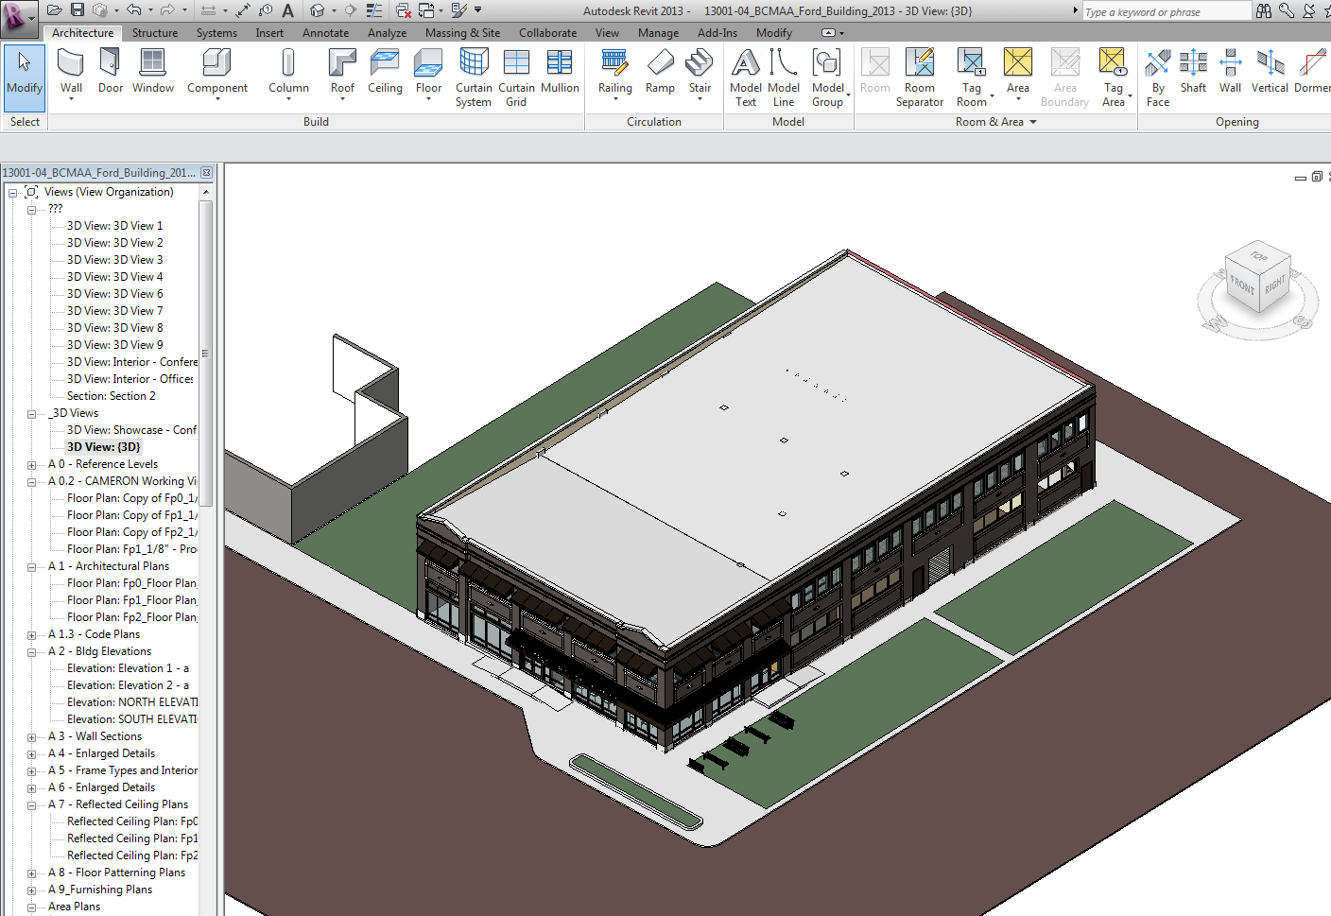
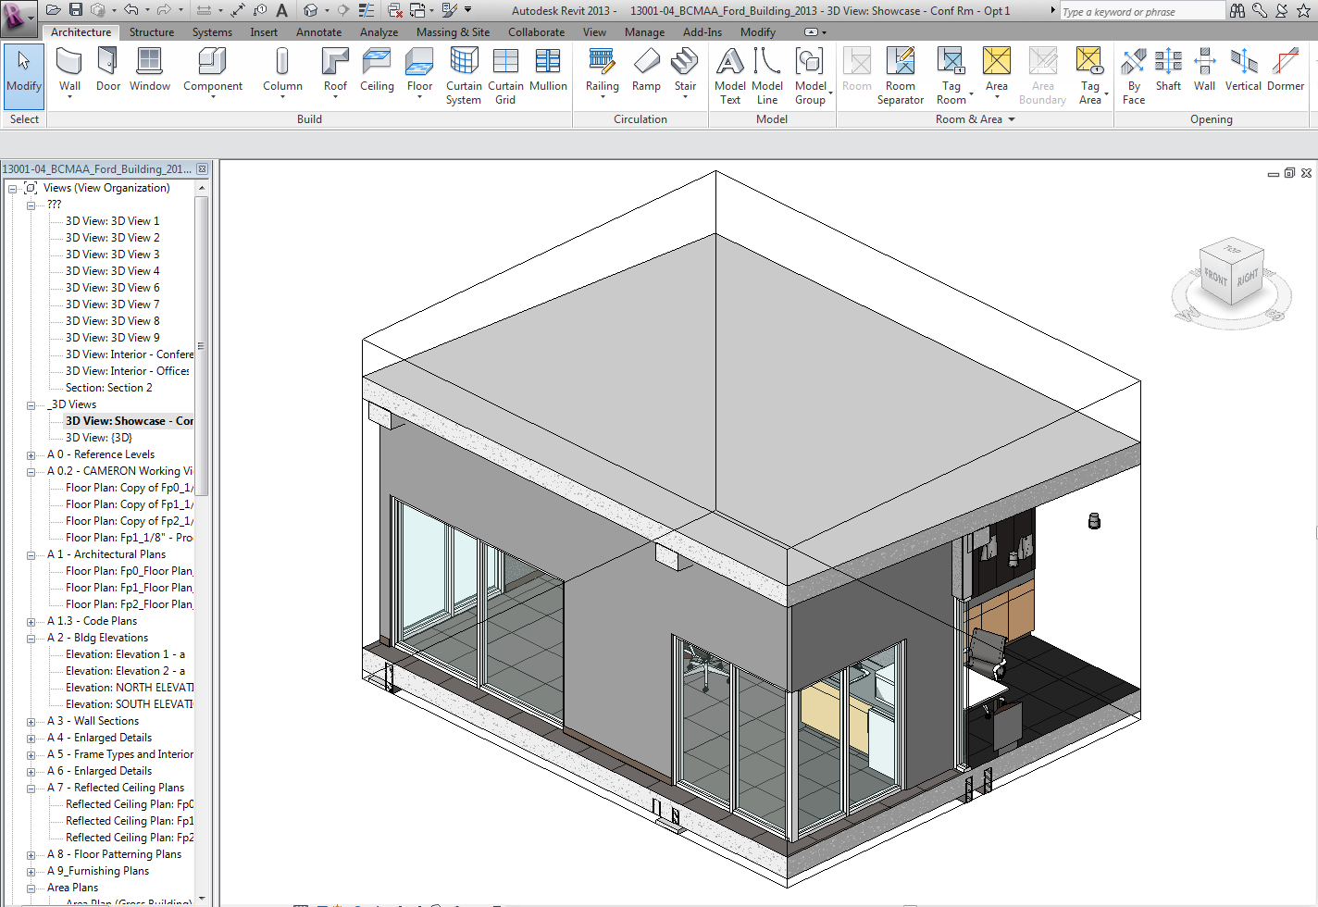
Showcase your Revit Model

Slide 20
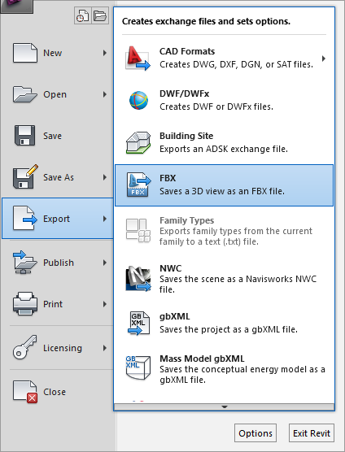
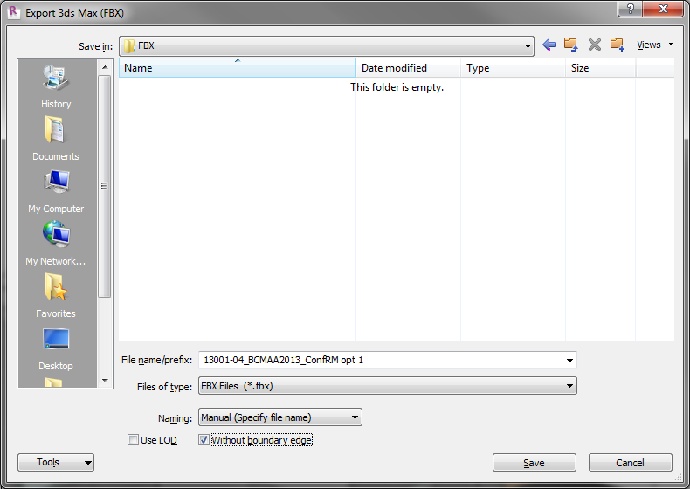
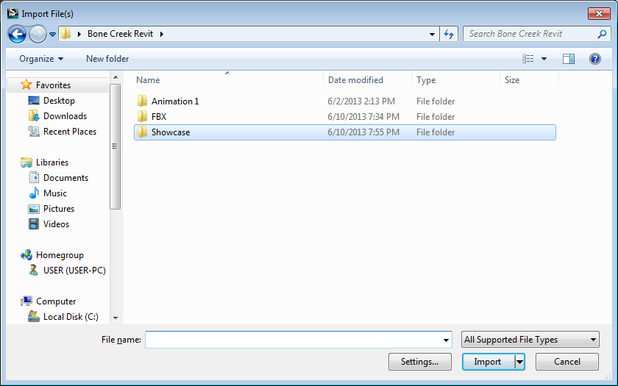
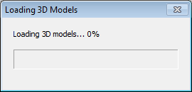
Showcase your Revit Model

Slide 21
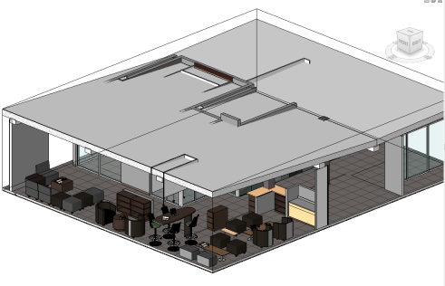
6 - Using Showcase with a Revit Model
Minor Pitfalls to avoid:
File naming and locations
Material Selection
Pivot Point Center
Major Pitfalls:
File size
Showcase your Revit Model

Slide 22
6 - Using Showcase with a Revit Model
Major Pitfalls:
File size
70Mb Revit model translates into about the largest file you would want to export to Showcase 2013 or 2014.
Fortunately, in this demonstration I’ve shown how to piece out the model into smaller sections resulting in 10Mb – 40Mb files.
Specs:
Dell T5500 with 2 – Xeon X5520 (2.26Ghz-2.53Ghz Turbo) Quad Core (16 Threads)
12Gb – 1067Mhz DRAM
Nvidia Quadro 600 – 1Gb Video Card
320Gb – WD Caviar Blue 10K hard-drive
Showcase your Revit Model

Slide 23
7 – Visual Demonstration
View 3D Revit – Export to Showcase – Begin presentation methods
Showcase Workflow Demonstration
PLUS Bonus Video if time permits about converting Revit to Sketchup for use in
Showcase
Keeping a current model for in-office Sketchup Users
In under 5 minutes!
Showcase your Revit Model

Slide 24
Thank you!
Questions, Comments?
We’ve covered a lot of material, so please feel free to ask about anything I’ve shown here today.
Revit, Showcase, exporting, design alternatives, Sketchup compatibility with Showcase.
Goodbye 2D, Hello 4D

